Slide 1
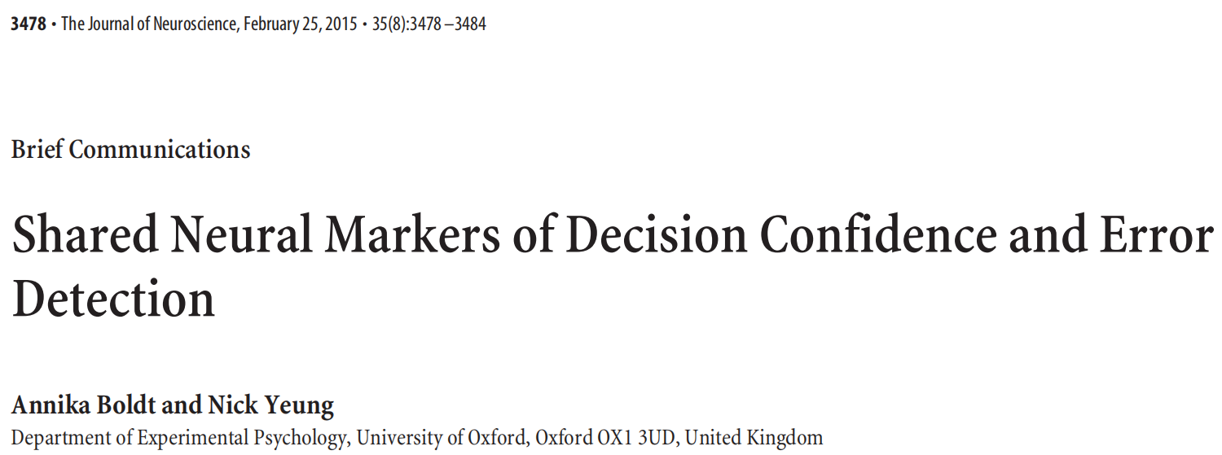
在此输入您的封面副标题

Slide 2
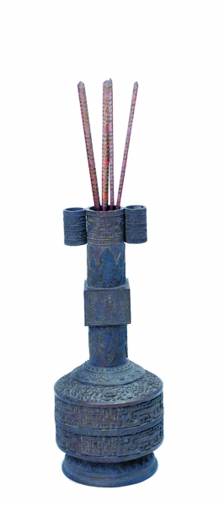

投壶

Slide 3
Introduction
Human observers are capable of finely calibrated evaluations of their performance. In perceptual decision tasks, for example, participants reliably detect their errors(Rabbitt et al., 1978) and report graded judgments of confidence that correlate closely with objective performance(Fleming et al., 2012).
Here we investigate the relationship between two key metacognitive evaluations—error detection and confidence judgments—that have separately been studied in detail but that are rarely compared directly.

Slide 4
Similar methodological approaches have been used in prior work on errors and confidence: the participant makes a first order perceptual decision and is then asked to evaluate this just made choice (either “how confident are you that you were correct?” or “did you make an error?”). Despite this similarity in approach, there is little compatibility between current theories of confidence and error detection(Yeung and Summerfield, 2012).

Slide 5
Popular models of confidence—balance-of-evidence hypothesis(Vickers and Packer, 1982), explain graded confidence judgments but not why participants sometimes state with certainty that an earlier response was incorrect.
Conversely, many theories propose error detection to be all or nothing(Falkenstein et al., 1991; Gehring et al., 1993) and therefore struggle to explain graded judgments of confidence.
The present study tested the hypothesis that error detection and confidence are fundamentally related, using multivariate EEG classification to assess whether they share a neural basis.

Slide 6
In contrast to prior work focusing on the error-related negativity(ERN), a frontocentral component observed immediately following errors.
We focus on the subsequent parietal focused error positivity (Pe) because of its established link to subjective error awareness (Overbeek et al., 2005; Steinhauser and Yeung, 2010).
The stimulus-locked P3 component, which has previously been reported to vary with subjective confidence (Hillyard et al., 1971).

Slide 7
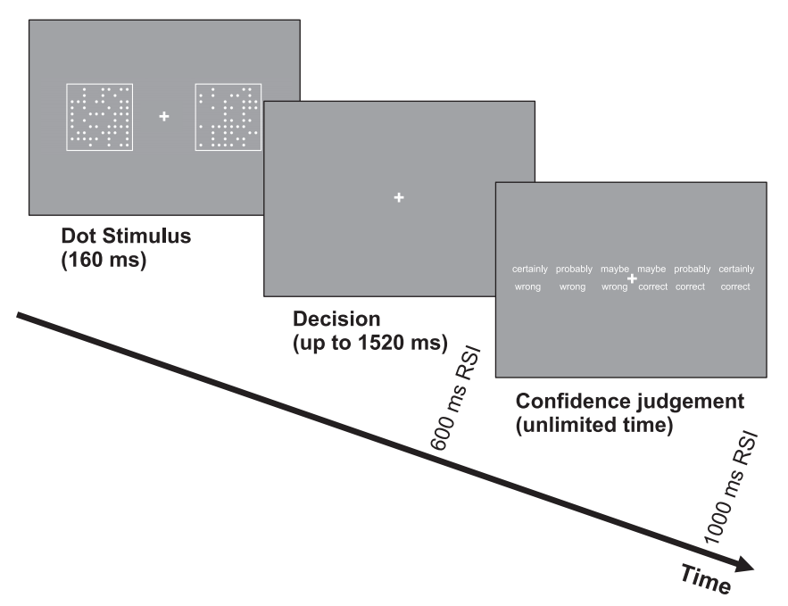
Materials and Methods
Participants: 16 right-handed participants (8 female), 21–30 years old.
Task and procedure: 18 experimental blocks of 48 trials. total 864 trials.
EEG recording: EEG data were recorded using the following Ag-AgCl electrodes in a fabric cap (QuikCap, Neuroscan) with 32 channels.
Electrode impedances were kept at < 50 kΩ. sampled at 1000 Hz.
Perceptual decision task under time pressure

Slide 8
Results
Behavioral data
ERP data
Single-trial EEG data

Slide 9
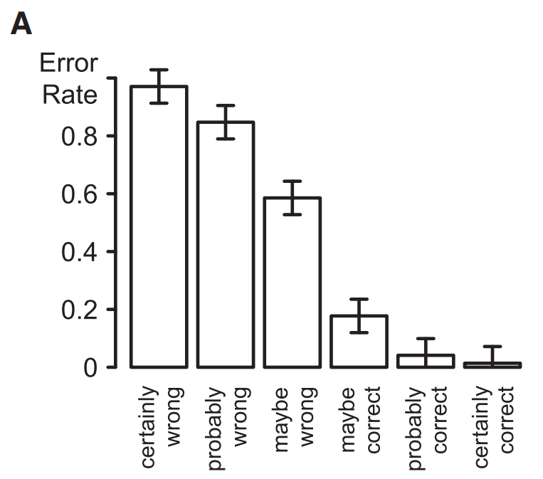
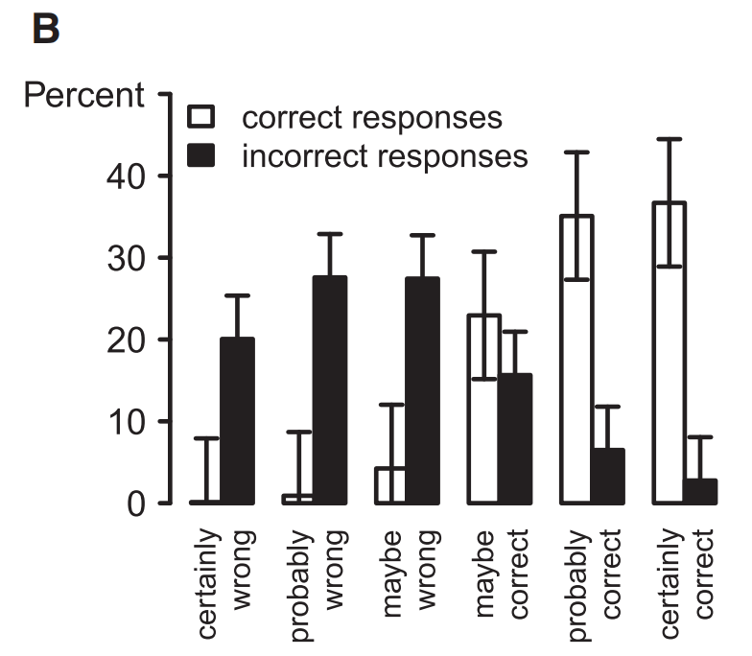
Behavioral data
A, Objective accuracy as a function of subjective confidence.
B, Distribution of confidence levels as a function of objective accuracy.
Error bars indicate within-subject confidence intervals.

Slide 10
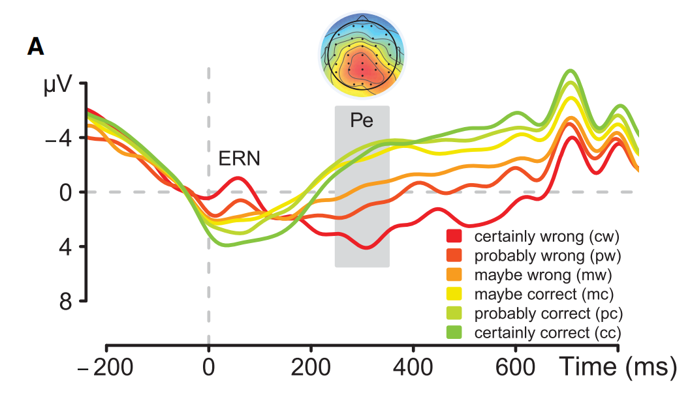
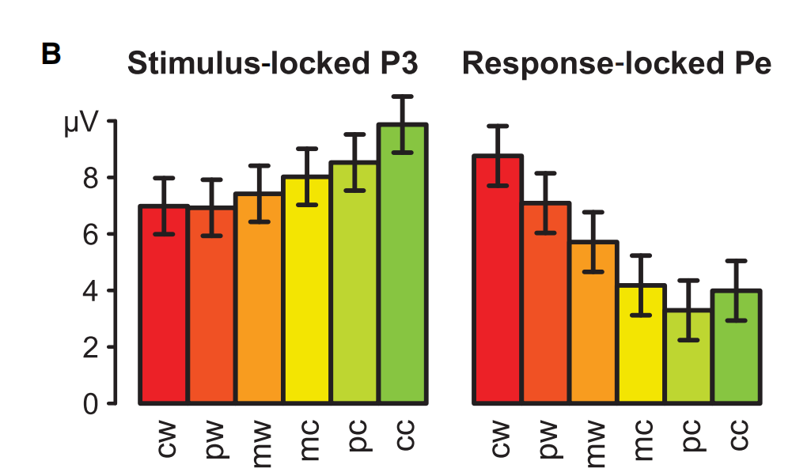
ERP data
250 –350 ms
-40 to 60 ms
A，Pe at electrode Pz, conditioned on level of confidence for errors and correct trials.
B, Stimulus-locked P3 and response-locked Pe at electrode Pz, conditioned on level of confidence for errors and correct trials with a prestimulus baseline for both potentials.

Slide 11
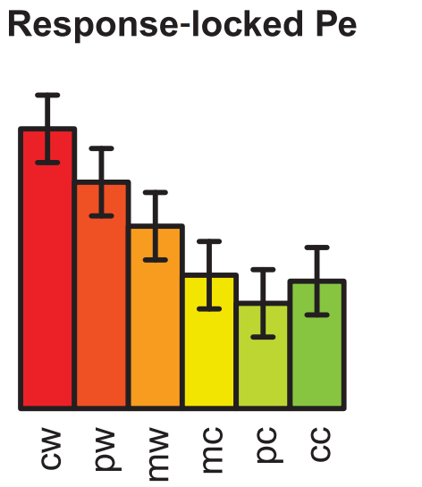
Summary and Question
These results extend previous ERN analyses (Scheffers and Coles, 2000) to demonstrate a clear association between Pe amplitude and confidence.
However, averaged ERPs are inherently ambiguous about the precise relationship between error-related neural activity and confidence.
It could be that amplitude reflects graded variation in confidence, as we hypothesize, but it could also be that error-related neural activity is all or none (Charles et al., 2013), with amplitude changes across confidence bins reflecting variation in proportions of trials on which this activity is triggered (i.e., from rarely, when participants feel “certainly correct”, to almost always, when they feel“certainly wrong”).

Slide 12
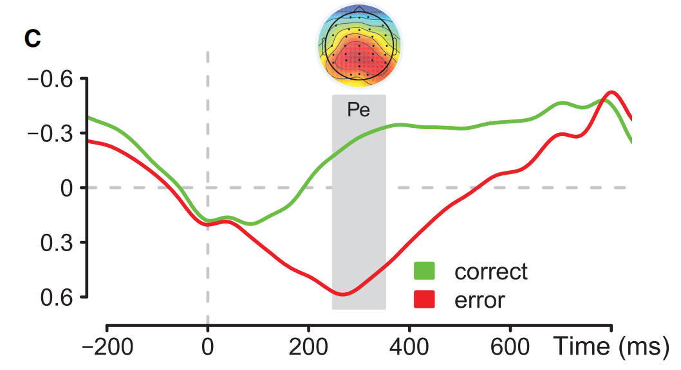
Single-trial EEG data
To distinguish between these alternative interpretations, we next used multivariate classification to robustly index Pe amplitude on individual trials.
Time course and spatial projection of the discriminating component identified by the classification analysis
of errors versus correct responses.

Slide 13
Our primary question was whether this classifier, trained to predict objective accuracy, would also predict variation in correct-trial confidence.
We therefore applied the classifying component to the response-locked EEG data from the subset of correct trials not used in classifier training, yielding an estimate of Pe amplitude for each time point on each of these trials. The resulting values were averaged across a moving window of 51ms, and for each time point were then split into quintiles(smallest to largest Pe amplitude).We then calculated the mean confidence within each quintile.

Slide 14
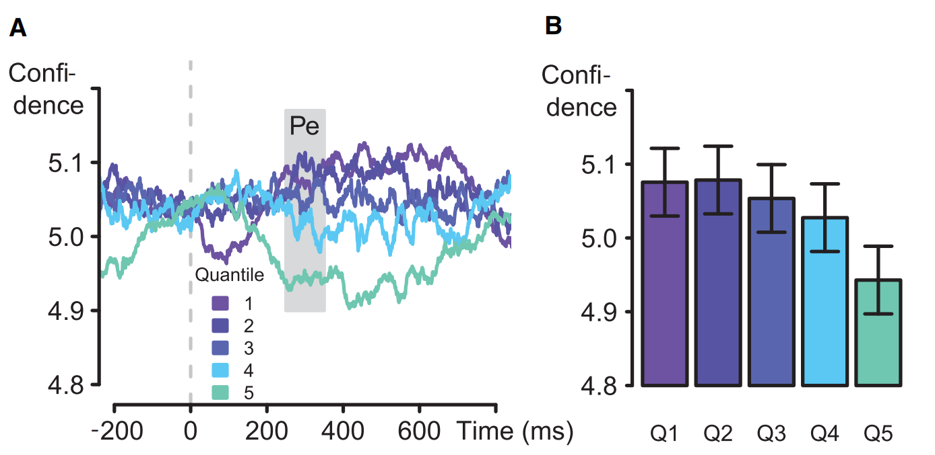
**
A, Moving average confidence (window width, 51 ms) for quintiles of discriminating components;
correct trials only (response locked); classifier trained on objective accuracy.
B, Averaged over a time window ranging from 250 to 350 ms poststimulus.
Error bars indicate within-subject confidence intervals.

Slide 15
Thus, a Pe-classifier trained to discriminate between objectively correct and incorrect trials was predictive of fine-grained differences in correct-trial confidence.
The present study provides new insight into the neural mechanisms of metacognition and the relationship between error monitoring and confidence. We find that the Pe, an EEG index of error processing, also varies with decision confidence on correct trials.
This result suggests that the information reflected in the Pe not only reflects graded certainty about having made an error (Steinhauser and Yeung, 2010) , but also reflects the graded certainty of having made a correct response— evidence that these judgments lie on a common continuum.

Slide 16
Discussion
The observed association of Pe amplitude with both error detection and decision confidence indicates that these two metacognitive evaluations reflect similar underlying mechanisms.
Our findings suggest a strong link between error awareness and decision confidence, with substantive implications for current theories in the respective fields.
The present findings bear on the question of whether neural correlates of error processing vary discretely or continuously, and help to resolve ambiguities in prior research on this question.
Our findings also have practical implications in showing that Pe amplitude provides a robust“noninvasive”index of confidence.

